Slide 1

TinyOS 2.1
Jun Yi
Partially based on the tutorial at IPSN 2009
By Stephen Dawson-Haggerty, Omprakash Gnawali, David Gay, Philip Levis, Răzvan Musăloiu-E.,
Kevin Klues, and John Regehr
Notes:
I am the TA of this course. I am going to give a tutorial on TinyOS and Nesc programming languages.

Slide 2
Outline
Overview
TinyOS and NesC
Programming Environment Setup
Notes:
I am going to introduce the tinyos, the operating system for the sensors and motes. The programming language,nesC, and sensor network programming environment and toolchain.

Slide 3
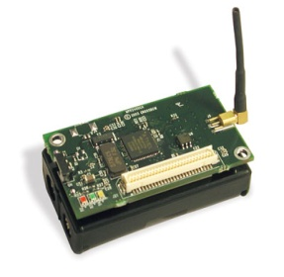


Overview
Sensor code
(nesC/TinyOS)
Base station code
(nesC/TinyOS)
Gateway code
(Java, c, …)
Wireless
Serial/USB
micaz/sensor
Notes:
Let me first introduce a typical sensor network and its components. At the left side are sensor nodes, usually consisting of a mote node and a sensor board for various sensing tasks. The mote node is like a old-time personal computer. It has a 8/16 bit CPU, 8-256K memory, and a low-speed radio. The operating system is installed into the flash memory of the mote. A sensor board is attached to the mote as a peripheral. The base station is also a mote, which is connected via serial or USB cable to a PC. The program running in the base station is for receiving messages and forwarding them to the PC, and receiving commands from the PC and dessiminate them to the sensor network. The PC with its application serves as a data analysis and control center

Slide 4
What is TinyOS?
An operating system for low power, embedded, wireless devices
  Wireless sensor networks (WSNs)
  Sensor-actuator networks
  Embedded robotics
Open source, open developer community
http://www.tinyos.net
E-book: TinyOS Programming: http://csl.stanford.edu/~pal/pubs/tinyos-programming.pdf
Notes:
The sensor network platform is supported by the TinyOS, just like PC is supported by Linux, Windos, and Mac. TinyOS is an operating system for low power, low-end, networked wireless devices. It is much simpler than traditional operating system. You can all the information on the official tinyos website and there is an excellent electronic book by the TinyOS author. The book is free to download. If you already read this book, you can ignore this tutorial.

Slide 5
TinyOS and nesC
Components and interfaces
  Blink example
Tasks
  Illustration
Compiling and tool-chain
Notes:
At a high level, TinyOS provides three things to make writing systems and applications easier: (1) a component model, which defines how you write small, reusable piece of code and compose them into larger abstractions; (2) a concurrent execution mode, which defines how components interleave their computations as well as how interrupt and non-interrupt code interact; (3)application programming interfaces (APIs), service, component libraries and an overall component structure that simpifying writing new applications and services.

Slide 6
TinyOS Components
TinyOS and its applications are in nesC
  C dialect with extra features
Basic unit of nesC code is a component
Components connect via interfaces
  Connections called “wiring”
A
interface
B
Notes:
TinyOS and its application are written using nesC programming language, which is a dialect of C.
The basic unit of nesC code are components. Components are wired by interfaces. The basic unit to wiring components are configurations

Slide 7
Components
A component is a file (names must match)
Modules are components that have variables and executable code
Configurations are components that wire other components together

Slide 8
Component Example
BlinkAppC wires BlinkC.Timer to TimerC.Timer
BlinkC
Timer
TimerC
module BlinkC {
uses interface Timer<TMilli>
as Timer0
provide interface xxxx}
implementation {
int c;
void increment() {c++;}
event void Timer0.fired()
{
call Leds.led0Toggle();
}
}
configuration BlinkAppC
{
}
implementation
{
components MainC, BlinkC, LedsC;
components new TimerMilliC()
as Timer0;
BlinkC.Timer0 -> Timer0;
BlinkC -> MainC.Boot;
BlinkC.Leds -> LedsC;
}
Notes:
We use the blink application as an example, the BlinkC module uses the interface provided by the Timer component. The blinkAppC wires them together. At the left side is the BlinkC code snippet, BlinkC declare its usage of the timer interface and inside its executable code, it uses the fire event function provided by the timer interface. At the right side is the BlinkAppC code snippet. It creates a Timer component and wire the timer component to the BlinkC component.

Slide 9
Singletons and Generics
Singleton components are unique: they exist in a global namespace
Generics are instantiated: each instantiation is a new, independent copy
configuration BlinkC { … }
implementation {
components new TimerC();
components BlinkC;
BlinkC.Timer -> TimerC;
}
Notes:
Component can be singleton and generic.

Slide 10
Interfaces
Collections of related functions
Define how components connect
Interfaces are bi-directional: for A->B
  Commands are from A to B
  Events are from B to A
Can have parameters (types)
interface Timer<tag> {
command void startOneShot(uint32_t period);
command void startPeriodic(uint32_t period);
event void fired();
}
Notes:
There are two kinds of functions an interface can declare: command and event.

Slide 11
Interface (provide and use)
User
Commands
Interface
Events
Provider
Module BlinkC {
use interface xxxx;
provide interface xxxxxxx;
.........
}
Notes:
If a component calls a command, it uses the interface and the component which implements this command is the provider of this interface. If a component calls an event function, it is the provider of the event, and the component which implements this event function is the user of the event. Remember that the command and event fucntions are dual.

Slide 12
Tasks
TinyOS has a single stack: long-running computation can reduce responsiveness
Tasks: mechanism to defer computation
  Tells TinyOS “do this later”
Tasks run to completion
  TinyOS scheduler runs them one by one in the order they post
  Keep them short!
Interrupts run on stack, can post tasks
Notes:
TinyOS has a single task queue and a single stack. Tasks are just special functons which can be posted into the task queue. The scheduler executes task in a FIFO order, that is, the one posted earlier will be executed earlier. Tasks can be interruptible or non-interruptable.

Slide 13
TinyOS Execution Model
Task Queue
Stack
Xxxxxx;
event void Timer0.fired()
{
xxxxxx;
xxxxxx;
xxxxxx;
xxxxxx;
call Leds.led0Toggle();
xxxxxx;
xxxxxx;
post remainingwork();
}
xxxxx;
remainingwork(){xxxx;};
xxxxx;
main
......
Timer0.fired
......
Timer0.fired
Led0Toggle
main
remainingwork
......
remainingwork
main
......
Notes:
Let’s look at an example, At the left side is a code snippet. The timer event function calls the LED function in the middle and post a task at the end. At the beginning, the task queue only contains the main task, which is the scheduler. While the timer event function is called, this function is put into the stack and the execution of this function starts. When the LED function is called, it is pushed into the stack, but the task queue is unchange since both the timer function and the LED function are within the same task. At the end of the timer function, it posts a task remainingwork. The task queue is appended with a this newly posted task. When the LED and Timer function finish, both of them are poped up. And the current task execution is finished, then the scheduler picks the next task, i.e., the remainingwork task, to execute. The remaining task is removed from the task queue and it is pushed into the stack for execution.

Slide 14
TinyOS/nesC Summary
Components and Interfaces
  Programs built by writing and wiring components
    modules are components implemented in C
    configurations are components written by assembling other components
Execution model
  Execution happens in a series of tasks (atomic with respect to each other) and interrupt handlers
  No threads
System services: startup, timing, sensing (so far)
  (Mostly) represented by instantiatable generic components
    This instantiation happens at compile-time! (think C++ templates)
  All slow system requests are split-phase
Notes:
In summary, TinyOS is component-based, and statically linked via interfaces. The execution model is simple, tasks runs to completion and there is only one task queue and one stack. The Tinyos already have many components, which provide timer, boot, storage, networking services, use them before you invent your own wheel.

Slide 15

“Make”: The Tool Chain
ncc
int main() {
scheduler_init();
...
}
gcc
Native binary:
03 2F 77
9A F2 FF
...
Notes:
NCC stands for nesC compiler. At the left side is the collection of nesC components. NCC compiles them into a standard C source code. Then GCC compile the C source code into binary code, based on the mote CPU architecture, which maybe X86 or PowerPC….

Slide 16
The “Make” System
TinyOS
PC Applications
App
Native binary:
03 2F 77
9A F2 FF
...
make micaz install mib520, /dev/ttyS0
automates nesC, C compilation,
mote installation
Notes:
The toolchain is complicated, it includes nesC compilation, C compilation, code installation. The make system automate the whole procedures by call the command on the screen.

Slide 17
Build PC Applications
java classname -comm serial@/dev/ttyS0:micaz
TinyOS
Packet formats, constants, etc
Java, C, Python apps
Talk with
motes
Native binary:
03 2F 77
9A F2 FF
...
Notes:
At the PC side, you need to use java or C to write your own data analysis or mote control application. In order to understand received message, the message format and system constant communicated between motes must be known to the application. TinyOS provides several tools to facilitate this job.

Slide 18
PC Applications:
Extracting Information from TinyOS
packet
formats
TinyOS
mig
Java, C or
Python
app
constants
ncg
Notes:
The first one is MIG, stands for message interface generator, it generates a java class from the message format definition file written in nesC. The other is NCG, stands for nesC constant generator, it generates a java class from the nesC constant definition file.

Slide 19
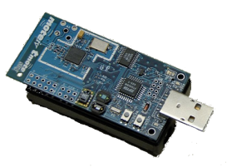
“Make”: Install Applications
Native binary:
03 2F 77
9A F2 FF
...
pybsl, uisp,
etc
deluge
Notes:
To upload the built program image one by one to all motes is tedious and time consuming, especially when the number of mote is large. So here comes the networking programming protocol, deluge. The base station can disseminate the program image to all motes. But in our project, we will not use it since the number of motes we use is small.

Slide 20
PC Applications:
Talking to Motes
Java, C or
Python
app
packet
libs
packet
libs
sf
Notes:
PC applications talk to mote usually through serial forwarder… which is a existing class in the java library provide by the tinyOS.

Slide 21
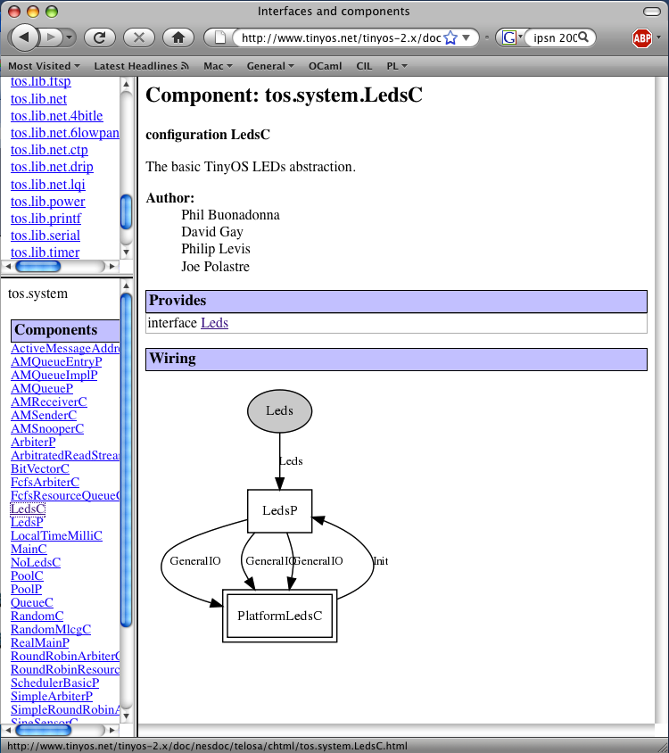
Document TinyOS
nesdoc
Notes:
Also, you can use nesdoc to automatically generate the component diagram of your program. If you have a large program, it can help you a lot.

Slide 22
Programming environment setup
Notes:
We will talk about the programming environment setup in this section

Slide 23
Goals
Install TinyOS cross-compilation environment
Build Blink application
Run Blink application
Notes:
Today we are going to try to achieve 3 goals. First we’ll look at the options available for installing TinyOS, then we will take a quick tour of the layout of the tinyos-2.x sources and then we’ll discuss and try to write two application: one based on dissemination and one based on collection.

Slide 24
Install TinyOS cross-development environment
  Install Vmware player on top of Linux or Windows
    http://downloads.vmware.com/d/info/desktop_downloads/vmware_player/3_0
  Run XubuntOS with Vmware player
    http://sing.stanford.edu
    Useranme: xubuntos; Password: tinyos
  Install USB-Serial Converter Driver (If USB cable is used)
    TrendNet TU-S9
Notes:
To install a tinyos cross-development environment, we need to download three tools: the VmWare player or workstation from vmware, the xubunto virtual machine, which is a image of customized linux cross-development environment, and optionally the USB-serial converter driver, some system already had it, but some operating systems don not have it, please install the driver if needed.
In my machine I already installed these three tools. So we directly go the virtual machine

Slide 25
Build Blink
Power on the programming board and connect to the COM port (the green light is flashing, otherwise, the board is dead)
Run Vmware player
cd /opt/tinyos-2.1.0/apps/blink
Make micaz
Make micaz install mib520,/dev/ttyS0
  Using dmesg to check the device name
  If permission denies: chmod 777 /dev/ttyS0
Blink is running, if red, blue, and gree LEDs are running alternatively.
Warning: switch both the programming board and mote off while programming the mote from the computer
Notes:
Since I used another kind of mote, it has a USB port so I can directly plug into my laptop, but for the Micaz, you need to connect the micaz to the laptop by a serial cable. The Micaz mote must be connected with a programming board, the programming board is connected via a serial cable to the PC. While the green light is flashing, the programming board is working, otherwise the programming board is dead. Next you need to run vmware player and load the virtual machine. I already loaded the machine here. Let’s go the opt/tinyos directly, here is the place of all the source code of tinyos and its applicaitons

Slide 26
DARTS lab
4 machines (2 linux-windows dual booted, and 2 Linux only), installed with Vmware player and Xubuntos, i.e., the programming environments are all set up
Each machine is already connected with a programming board which is attached with a Micaz and a sensor (MTS310)
Additional motes/sensors/programming-boards/seria-cables/power-lines can be found in a box in the coffe table

Slide 27
Some important environment variables
export PATH=$HOME/local/bin:$PATH
export TOSROOT=$HOME/local/src/tinyos-2.x
export TOSDIR=$TOSROOT/tos
export MAKERULES=$TOSROOT/support/make/Makerules
export CLASSPATH=$TOSROOT/support/sdk/java/tinyos.jar:.:$TOSROOT/support/sdk/java
export PYTHONPATH=.:$TOSROOT/support/sdk/python:$PYTHONPATH
export PATH=$HOME/local/src/tinyos-2.x/support/sdk/c:$PATH
All of them are in /opt/tinyos-2.1.0/tinyos.sh, so you (may) need to run it every time.
Notes:
This is the way the environment needs to be setup. The most important one is the MAKERULES because that we are going to include in the Makefiles of any applications.

Slide 28
Some important commands
Build mote application
  For Micaz: make micaz reinstall mib520,/dev/ttyS0
  For Telosb: make telosb reinstall bsl,/dev/ttyUSB0
Build PC application (Java)
  For micaz: java xxxx –comm serial@/dev/ttyUSB0:telosb
Determine mote device name:
  dmesg | grep tty*
List detected motes:
  MoteList

